Slide 1

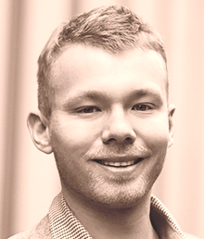
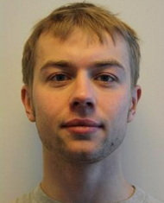


Learning to Discover Efficient Mathematical Identities
Wojciech Zaremba¹
Karol Kurach² and Rob Fergus^{1,3}
¹ New York University
² University of Warsaw, Google Zurich
³ Facebook AI Research

Slide 2

Motivation
Recent progress on perceptual tasks
Deep Learning for vision, speech, NLP
But little work on other classic AI problems
This work: an attempt to apply ML techniques to a discrete search problem
Encountered in many AI tasks.

Slide 3

The Combinatorial Explosion
Discrete search is a central issue in AI
“….failure to recognise the implications of the combinatorial explosion. This is a general obstacle to the construction of a self-organising system on a large knowledge base which results from the explosive growth of any combinatorial expression, representing numbers of possible ways of grouping elements of the knowledge base according to particular rules, as the base's size increases.”
“Artificial Intelligence: A General Survey” by Professor Sir James Lighthill, 1973.

Slide 4
Math
Theorem proving
Requires search over all possible combinations of operators
Intractable for all but simple proofs
Automated Theorem Provers use heuristics
Yet (some) humans are able to do it
Have experience of related problems
Known math “tricks”
We focus on simpler problem: discovering identities

Slide 5
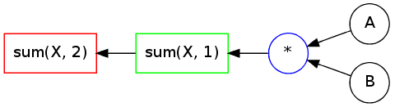
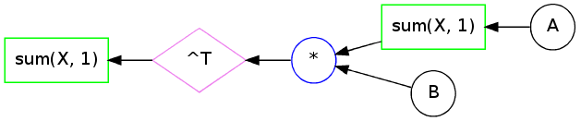
Toy Example
Consider two matrices A and B:
Naive computation takes O(n³):
An equivalent O(n²) computation:

Slide 6
Discovering Efficient Identities
Define a grammar G of operators
Given some target expression T within the domain of G
E.g. sum(sum(A*B,2),1)
Find an identical expression that has lower computational complexity
i.e. avoids high complexity operators

Slide 7
Overview
Representation of math expressions
Searching over expressions
Distributed representation of expressions using a recursive neural network

Slide 8
Grammar Rules
Matrix-matrix multiply X * Y
Matrix-vector multiply X * y
Matrix-element multiply X .* Y
Matrix transpose X’
Column-sum sum(X,1)
Row-sum sum(X,2)
Column-repeat repmat(X,1,m)
Row-repeat repmat(X,n,1)

Slide 9
Allowable Expressions
Variables: matrix or vector
Result: scalar
Targets are homogenous polynomials
i.e. only contain terms of same degree
(ab + a² + ac) (all terms are degree 2)
but not (a² +b)
Still includes many useful expressions

Slide 10
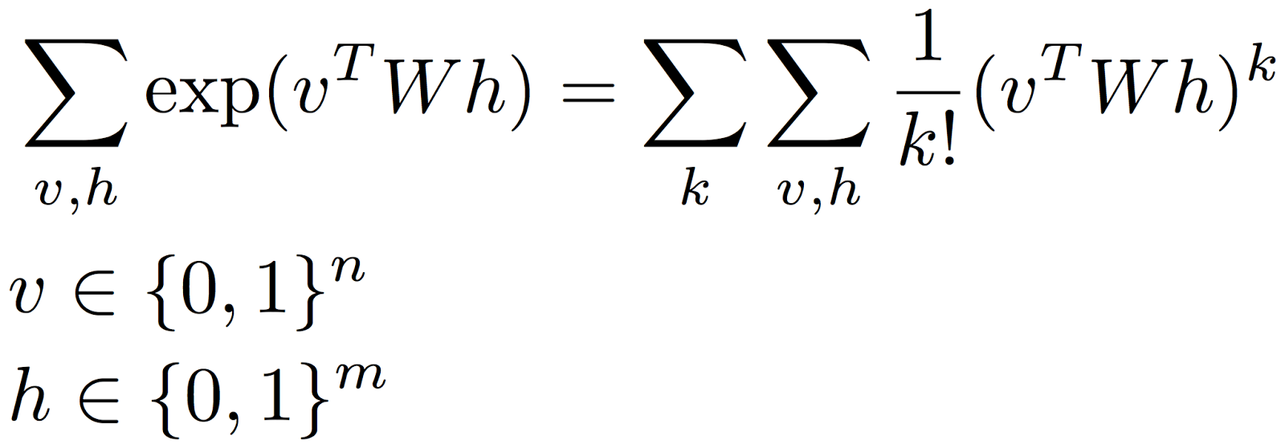
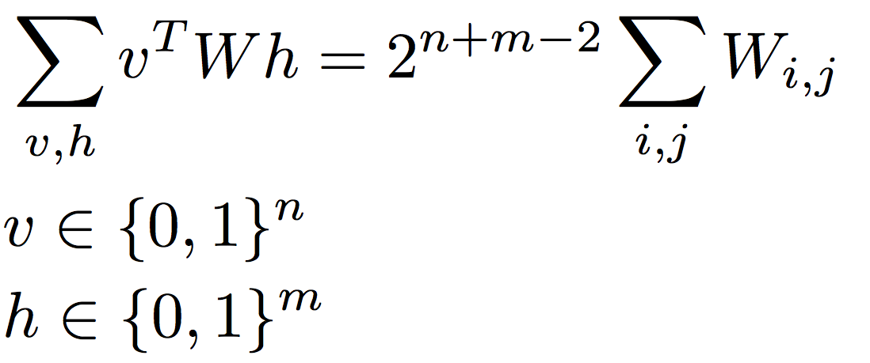
Example: Taylor Series Approximation
Consider RBM partition function:
1st term in Taylor series:

Slide 11
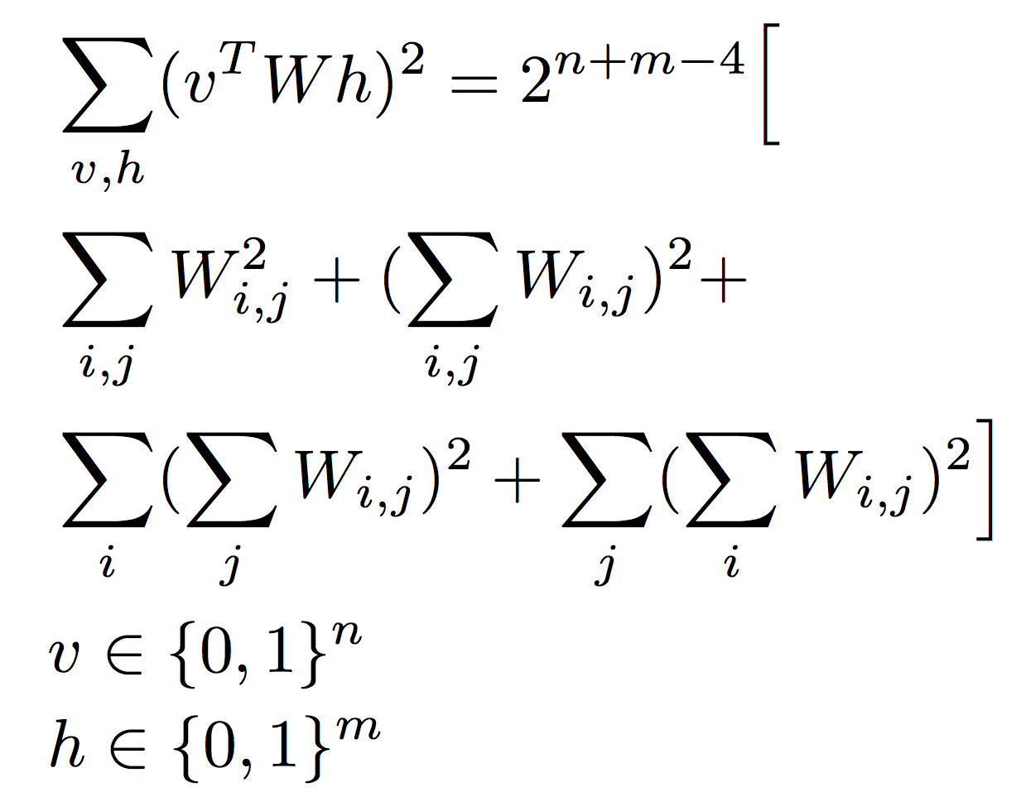
Example: Taylor Series of RBM Partition Function
2nd term in Taylor series:
Note that identity is O(n²)
versus O(2^{(n+m)}) for original expression

Slide 12
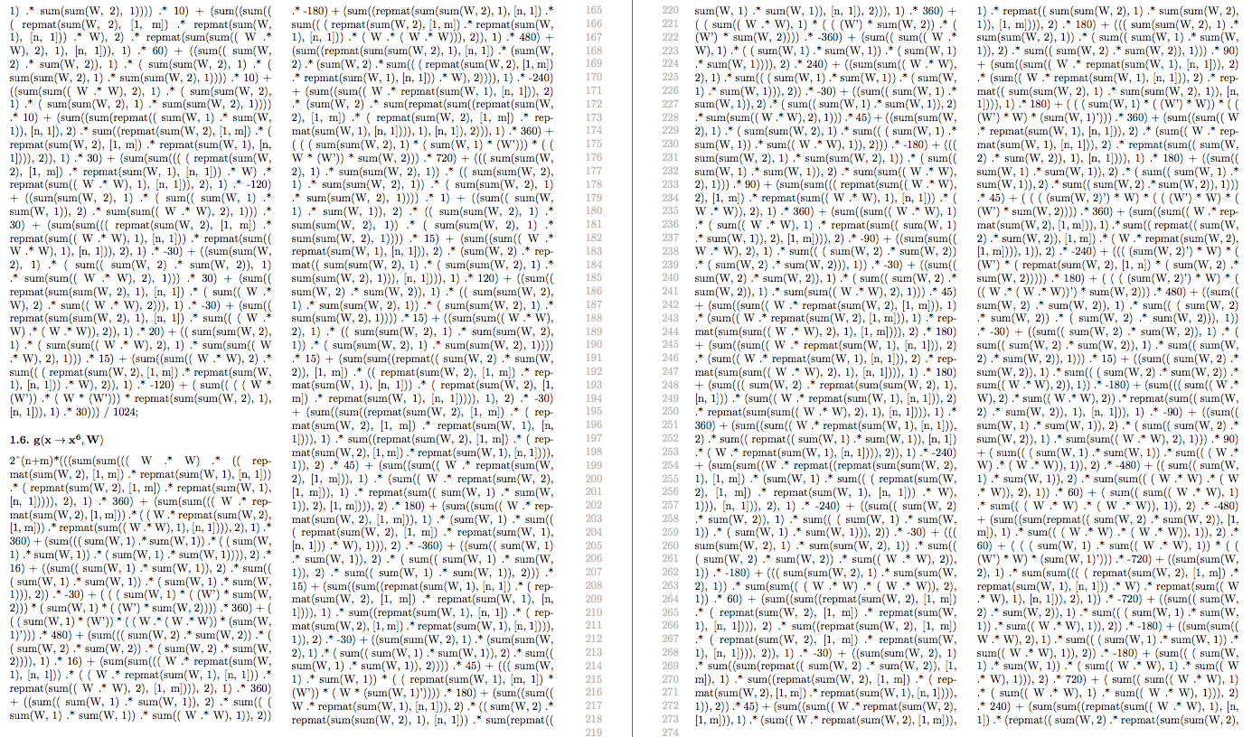
Example: Taylor Series of RBM Partition Function
What about higher order terms?
Too complex for manual derivation (we tried)
6th order:
Our framework can find it
O(n³)

Slide 13
Representing Symbolic Expressions
Pure symbolic too slow
Use numerical representation
Pick P random numbers (P large) for each element of each variable
So for an r x c matrix, we have P copies, each filled with random numbers
Important detail: we use fixed r and c
No definitive guarantee for other dimensions

Slide 14

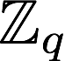
Representing Symbolic Expressions
Target expression: sum(sum(A*A’,1),2)
Use P copies of A
Representation of target is descriptor vector (length P)
Each element is evaluation one copy
Vector is of length P
If descriptors match → equivalent expressions
Using is unstable, so use
Integers modulo q, where q is large prime

Slide 15
Overview
Representation of math expressions
Searching over expressions
Distributed representation of expressions using a recursive neural network

Slide 16
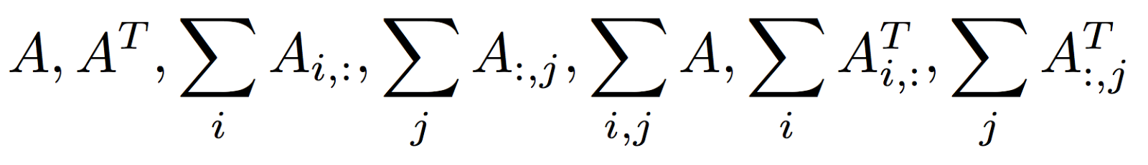
Combinatorial Explosion
Polynomials of degree 1:
Polynomials of degree 2:
Space grows exponentially fast:

Slide 17
Prior Over Computation Trees
Recall goal: find equivalent expressions to target
i.e. descriptors match
Restrict grammar to use operators with lower complexity than target
If any match found then sure to be efficient w.r.t. target
Want to learn a good prior over expressions

Slide 18
Searching over Computation Trees
Scheduler picks potential new operators to append to current expression(s)
Example:
Current expression:
Valid operators to append:
2
.*

Slide 19
Searching over Computation Trees
Scorer ranks each possibility (i.e. how likely they are to lead to the solution), using prior
Sample new operator according to scorer probabilities
Score: 0.3
2
Score: 0.05
Score: 0.65

Slide 20
Linear Combinations of Trees
Simple targets can be matched with a tree
But more complex ones require linear combination of different trees
Target expression
Efficient expression
(1 / 2) ∗ (((sum(A, 2)) ∗ (sum(A, 2)))) + (-1 / 2) ∗ ((A ∗ (A’)));
➔
w₁ ∗ tree₁ + w₂ ∗ tree₂

Slide 21
Linear Combinations of Trees
Given set of M trees currently explored, solve:
where are tree descriptors and is target descriptor
If solution exists, we are done!
Multiple solutions are possible
If no solution, then explore another tree & retry

Slide 22
Scorer Strategy
Naïve: no prior
Just select randomly from all valid operators
n-gram prior
Recurrent Neural Network prior

Slide 23
N-gram Prior
Use curriculum learning approach
Start with easy targets (low polynomial degree k)
Find solutions using naïve strategy, e.g.:
Build n-gram prior from these
Apply to harder target (next degree k)
Refine prior using new solution
Target expression
Efficient expression
K=2: sum(((sum(A, 1)) .∗ (sum(A, 1))) , 2)
K=3: sum((sum(((repmat((sum((repmat((sum(A, 1)), n, 1) .∗ A), 2)), 1, m) .∗ A) .∗ A), 2)), 1)
K=4: sum((sum((repmat((sum((repmat((sum(((repmat ((sum(A, 1)), n, 1) .∗ A) .∗ A), 2)), 1, m) .∗ A) , 1)), n, 1) .∗ A), 2)), 1)

Slide 24
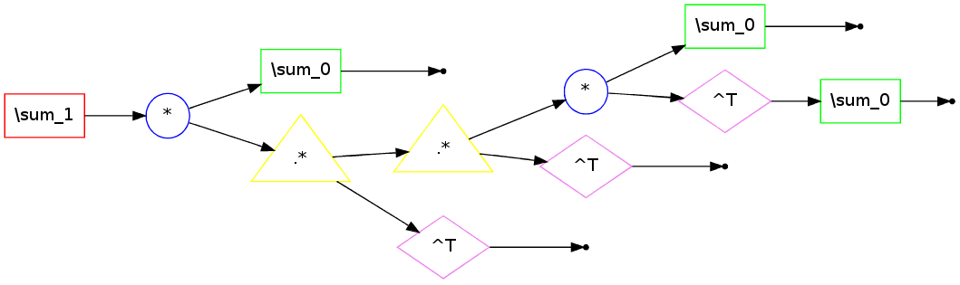
Building N-gram Prior
Break solutions into n-grams
Example solution: (bi-grams)
Prior is histogram of n-grams:
All possible n-grams

Slide 25
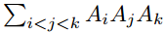
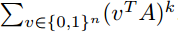
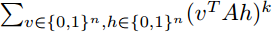
Experiments
5 families of expressions (vary degree k)
Multiply-sum:
Element-wise multiply-sum:
Symmetric polynomials:
RBM-1:
RBM-2:
Start with k=1 and work up to k=15
Time cut-off: 600 seconds
Repeat 10 times, measure fraction successful

Slide 26
K=2: sum((A ∗ ((sum(A, 1)) ’)) , 1);
K=5: sum((A ∗ ((((A ∗ (((sum((A’), 1)) ∗ A)’))’) ∗ A)’)), 1)
K=9: sum((A ∗ ((((A ∗ ((((A ∗ ((((A ∗ (((sum((A’), 1)) ∗ A)’))’) ∗ A)’))’) ∗ A)’))’) ∗ A)’)), 1))
K=14: sum((A ∗ ((((A ∗ ((((A ∗ ((((A ∗ ((((A ∗ ((((A ∗ ((((A ∗ ((sum(A, 1)) ’)) ’) ∗ A) ’)) ’) ∗ A) ’)) ’) ∗ A)’))’) ∗ A)’))’) ∗ A)’))’) ∗ A)’)), 1)

Slide 27
K=2: sum(((sum(A, 1)) .∗ (sum(A, 1))) , 2)
K=3: sum((sum(((repmat((sum((repmat((sum(A, 1)), n, 1) .∗ A), 2)), 1, m) .∗ A) .∗ A), 2)), 1)
K=4: sum((sum((repmat((sum((repmat((sum(((repmat((sum(A, 1)), n, 1) .∗ A) .∗ A), 2)), 1, m) .∗ A) , 1)), n, 1) .∗ A), 2)), 1)

Slide 28
K=2: (1 / 2) ∗ (((sum(A, 2)) ∗ (sum(A, 2)))) + (50 / −100) ∗ ((A ∗ (A’)));
K=3: (1 / 6) ∗ ((sum(((sum(A, 2)) ∗ ((sum(A, 2)) ∗ A)) , 2))) + (50 / −100) ∗ ((A ∗ (((sum(A, 2)) ∗ A) ’) )) + (1 / 3) ∗ (((A .∗ A) ∗ (A’)));
K=4: (25 / −100) ∗ ((A ∗ (((sum(A, 2)) ∗ ((sum(A, 2)) ∗ A))’))) + (1 / 8) ∗ ((A ∗ ((A ∗ ((A’) ∗ A)) ’))) + (1 / 3) ∗ (((A ∗ ((A’) .∗ (A’))) ∗ (sum(A, 2)))) + (25 / −100) ∗ (((((A’) .∗ (A’))’) ∗ ((A’) .∗ (A’)))) + (1 / 24) ∗ ((sum(((sum(((sum(A, 2)) ∗ ((sum(A, 2)) ∗ A)), 2)) ∗ A), 2)));

Slide 29
RBM-1:
K=2: 2ˆ(n − 3) ∗ (2 ∗ ((sum(((A .∗ A) ’) , 1))) + 2 ∗ ((sum(((A’) .∗ repmat((sum((A’) , 1)) , m, 1)) , 1))))
K=3: 2ˆ(n − 4) ∗ (6 ∗ ((sum((((((A’) .∗ repmat((sum((A’) , 1)) , m, 1)) ’) .∗ A) ’) , 1))) + 2 ∗ ((sum(((A’) .∗ repmat((sum(((A’) .∗ repmat((sum((A’) , 1)) , m, 1)) , 1)) , m, 1)) , 1))));
K=4: 2ˆ(n − 5) ∗ (12 ∗ (((sum(((A .∗ A) ’) , 1)) .∗ (sum(((A’) .∗ repmat((sum((A’) , 1)) , m, 1)) , 1)))) + 6 ∗ (((sum(((A .∗ A) ’) , 1)) .∗ (sum(((A .∗ A) ’) , 1)))) + 2 ∗ ((sum(((A’) .∗ repmat((sum(((A’) .∗ repmat((sum(((A’) .∗ repmat((sum((A’), 1)), m, 1)), 1)), m, 1)), 1)), m, 1)), 1))) +−4∗ ((sum (((((((A .∗ A)’) .∗ (A’))’) .∗ A)’), 1))));

Slide 30
RBM-2:
No scorer strategy able to get beyond k=5
However, the k = 5 solution was found by the RNN consistently faster than the random strategy (100 ± 12 vs 438 ± 77 secs).
K=5 solution:
2ˆ(n+m)∗(((sum(sum((repmat(( sum(A, 1) .∗ sum(A, 1)), [n, 1]) .∗ ( ( repmat(sum(A, 2), [1, m]) .∗ repmat(sum(A, 1), [n, 1])) .∗ A)), 2), 1) .∗ −40) + (sum((( sum(A, 1) .∗ sum(A, 1)) .∗ sum((repmat(sum(A, 1), [n, 1]) .∗ ( repmat(sum(A, 2), [1, m]) .∗ repmat(sum(A, 1) , [n, 1]))) , 1)) , 2) .∗ −10) + (( sum(sum(A, 2), 1) .∗ sum(( ( sum(A, 2) .∗ sum(A, 2)) .∗ sum(( A .∗ A), 2)), + (sum(( repmat (sum(sum(A, 2) , 1) , [n , 1]) .∗ ( repmat (sum(sum(A, 2) , 1) , [n , 1]) repmat(sum(A, 2) , [1, m]) .∗ repmat(sum(A, 1) , [n, 1])) .∗ A) , 2))) , 1) + (sum((sum(( A .∗ repmat(sum(A, 1) , [n, 1])) , 2) .∗ sum((repmat(sum(A, 1) , [n, 1)) .∗ −60) .∗ sum(( (.∗ 60) ... 1]) .∗ (repmat(sum(A, 2) , [1, m]) .∗ repmat(sum(A, 1) , [n, 1]))) , 2)) , 1) .∗ 60) + sum(sum( ( ( repmat(sum(A, 2) , [1, m]) .∗ repmat(sum(A, 1) , [n, 1])) .∗ ( A .∗ ( A .∗ A))) , 2) , 1) .∗ 80) + (sum((sum(A, 2) .∗ (sum(A, 2) .∗ sum(( ( repmat(sum(A, 2) , [1, m]) .∗ repmat(sum(A, 1) , [n, 1])) .∗ A), 2))), 1) .∗ −40)+ (sum((repmat(sum(( sum(A, 2) .∗ sum(A, 2)), 1), [n, 1]) .∗ sum(( ( repmat(sum(A, 2), [1, m]) .∗ repmat(sum(A, 1), [n, 1])) .∗ A), 2)), 1) .∗ 60) + ( ( ( sum(A, 1) ∗ (A’)) ∗ ( ( A ∗ (A’)) ∗ sum(A, 2))) .∗ 120) + (sum((( sum(A, 2) .∗ sum(A, 2)) .∗ sum((repmat(sum(A, 2), [1, m]) .∗ ( repmat(sum(A, 2), [1, m]) .∗ repmat(sum(A, 1) , [n, 1]))) , 2)) , 1) .∗ −10) + (( sum(sum(A, 2), 1) .∗ sum(( ( sum(A, 1) .∗ sum(A, 1)) .∗ sum(( A .∗ A), 1)), 2)) .∗ −60) + (sum((sum(repmat(( sum(A, 2) .∗ sum(A, 2)), [1, m]), 1) .∗ sum((repmat(sum(A, 2), [1, m]) .* ( repmat(sum(A, 2) , [1, m]) .∗ repmat(sum(A, 1) , [n, 1]))) , 1)) , 2) .∗ 15) + ( ( ( sum(sum(A,
.......

Slide 31
Overview
Representation of math expressions
Searching over expressions
Distributed representation of expressions using a recursive neural network

Slide 32

Recursive Neural-Network (RNN)
Two training stages (both supervised):
Pre-training
Use RNN to embed symbolic expressions in
Equivalent expressions should be close
RNN “learns structure of math”
Fine-tuning for a particular family of expressions
Train softmax classifier on top of RNN embedding
Predict which operator to add to current expression
Training data from simpler expressions in family

Slide 33
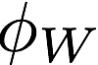
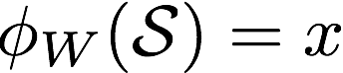
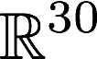
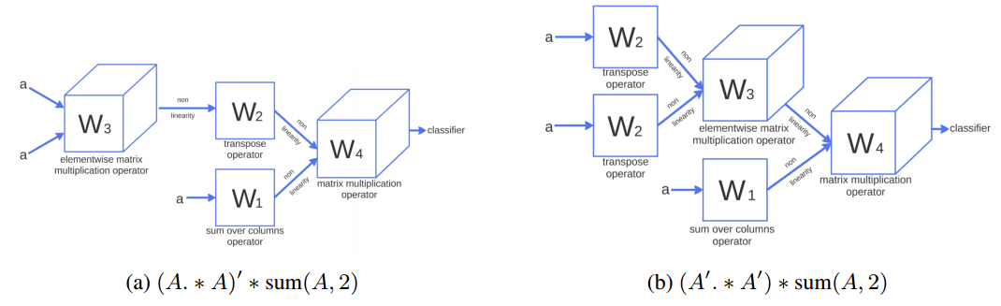

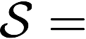
RNN Architecture
Input to RNN is symbolic expression
Output is embedding vector in
Variables represented as random vectors in
Each operator represented by:
matrix/tensor
then ReLU
E.g. A^{T}
max( W₂*a , 0 )
Related to Bowman et al. 2014 (Logic) and Socher et al. (2013) (Sentiment Analysis)

Slide 34
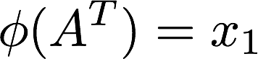
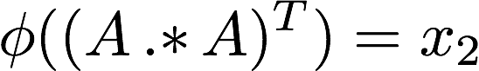
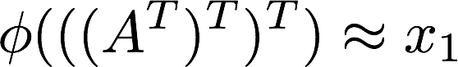
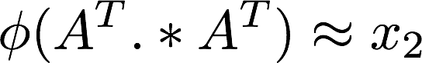
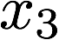
RNN Pre-Training
RNN maps expression to vector
Two examples:
But want RNN to “understand” math, i.e.:

Slide 35
RNN Pre-Training
Training data: for each degree find groups of equivalent expressions (exhaustive search)
Label each group as a different class
Add softmax classifier to RNN and train with cross-entropy loss
Training examples for degree k=6:
Important tricks:
Initialization as identity + noise (critical)
Curriculum learning
Softmax matrix has x100 learning rate

Slide 36
RNN Pre-Training Results
Test scenario:
Example from class A:
Example from class B:
Which class is this example ?
Note: no explicit knowledge of math operators

Slide 37
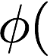
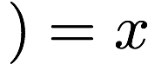
Building Prior from RNN
Take solutions from lower degrees within family
Pass each part through pre-trained RNN
Train softmax classifier to predict next operator
At test-time, use softmax probabilities as score
SoftMax
2

Slide 41
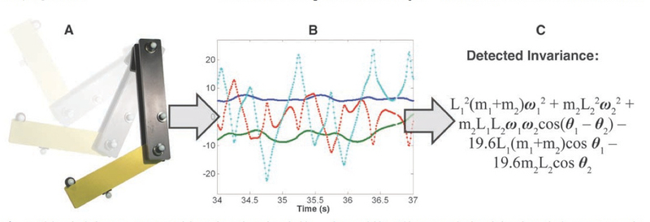
Related Work
Recent efforts to combine ML with theorem provers, e.g. Bridge et al. 2014
Distilling Free-Form Natural Laws from Experimental Data, Michael Schmidt and Hod Lipson. Science, Vol. 324, April 3, 2009.
Recursive neural nets in NLP:
NLP: Socher et al. 2013, Luong et al.
Bowman et al. 2014 for logical predicates
Embeddings of word & sentances
Collobert & Weston, Mikolov et al.

Slide 42
Related Work
Learning to Execute, Wojciech Zaremba & Ilya Sutskever, arXiv 1410.4615, 2014
Input: Python programs in text form
Model: Recurrent Neural Network
Goal: Predict numerical output of program

Slide 43
Summary
Simple statistical priors over expressions like n-gram allows the discovery of many new math formulae
But not helpful for some math families (e.g. RBM-2)
Some formulae useful for ML problems
E.g. closed-form dropout or partition function approximation
Neural nets able to map computational expressions to continuous vectors
Not a natural domain for neural nets
Curriculum learning crucial technique
Learn from solutions to simple expressions

Slide 44
Future Work
Try techniques in super-compilers
Compilers that replace code with more efficient versions
Extend grammar to explore more general expressions
Apply Deep Learning to other AI problems
Paper appearing at NIPS 2014
Code: https://github.com/kkurach/math_learning

Slide 45
END

Slide 46
Sym_k

Slide 47
RNN Pre-Training
Training data: for each degree find groups of equivalent expressions (exhaustive search)
Label each group as a different class
Add softmax classifier to RNN and train with cross-entropy loss
Training examples for degree k=6:
Results:

